Slide 1
12.06.2024
Welcome to
Technische Hochschule
Ingolstadt
Prof. Dr. …
Visit of…

Slide 2


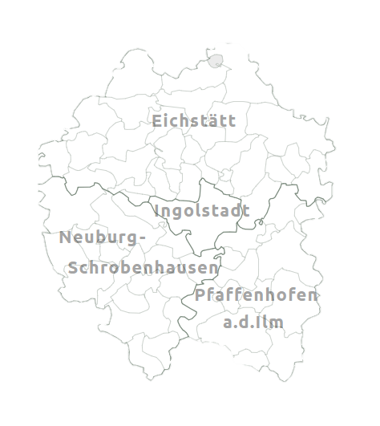










At a glance
Region Ingolstadt
Center of the automotive and aviation industry
Science location: Two universities and Fraunhofer Institute
Large number of medium-sized companies (Suppliers, engineering service providers, trading companies)
Digital business incubator and test fields

Slide 3



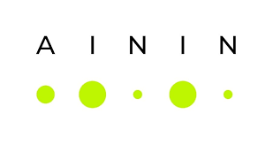





Key Facts
Technische Hochschule Ingolstadt
Milestones
140
PhD students
8
Research institutes
of which 25 M-€ p.a. third-party funding
New campus in Neuburg
(WS 20/21)
6
Faculties
AImotion Bavaria
(2019)
300 Scientific employees
40 Research professors
85 M-€ p.a. Total budget
205 Professors
AININ
(2019)
330
Industry- and research partner
Fraunhofer
(2019)
870 Employees
60
Technical
Laboratories
Bavarian Foresight-Institut
(2022)
41
Bachelor's degree programmes
32 M-€. p.a. Research volume
ForTraNN (2022)
7.500
Students
TTZ Manching
(2023)
35
Master‘s degree programmes

Slide 4
Growth since the beginning
Development of THI
AININ & Fraunhofer Application center
2019
Inauguration Campus Neuburg
2021
CARISSMA
2016
AI-mobility
center
2020
Expansion Stage II
2017
Extension building
2014
Appointment to
Technische Hochschule
2013
Foundation
IAW
2008
Decision on expansion stage I
2005
Foundation ZAF
2004
Moving into new building
1998
Setting-up
1994

Slide 5
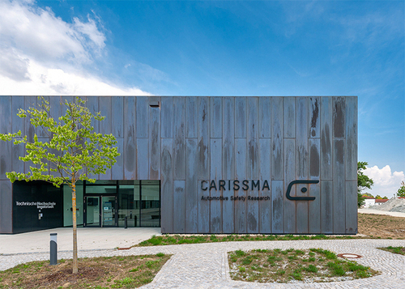
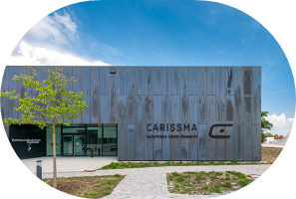


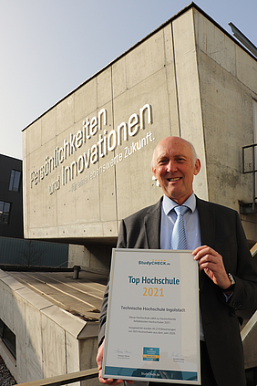
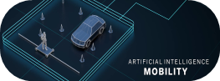


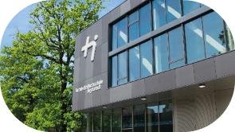

Awards
2010:
First research building at a University for Applied Sciences in Germany
2020:
TOP employer FOCUS-Business
2016:
Leading scientific center for vehicle safety
2013:
Appointment to
“Technische Hochschule“
2019:
AI-mobility center as part of the Hightech Agenda Bavaria
2008:
Award „Bavarian Innovation Prize“
Nomination
for the
German
Innovation Prize
2021:
TOP 10 at studycheck.de

Slide 6
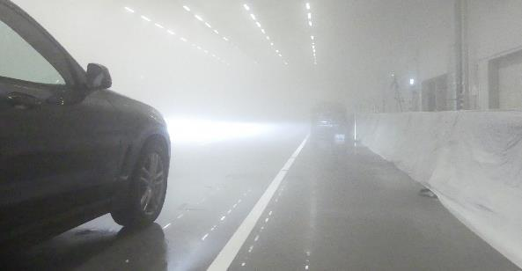
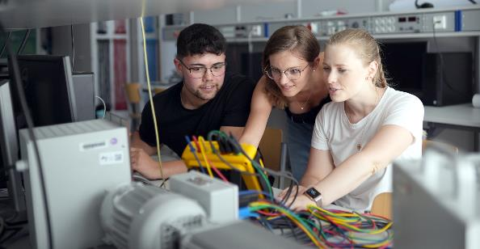
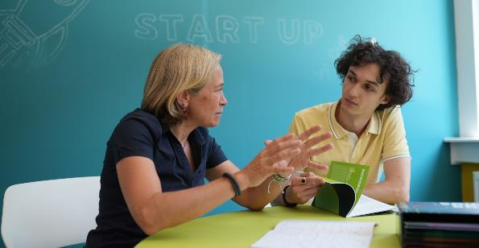
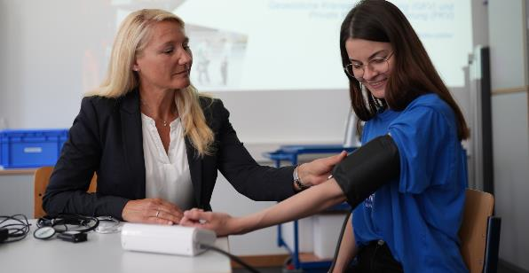
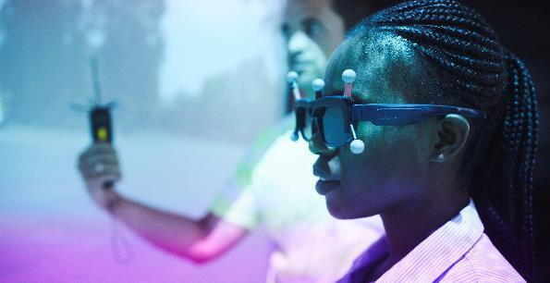
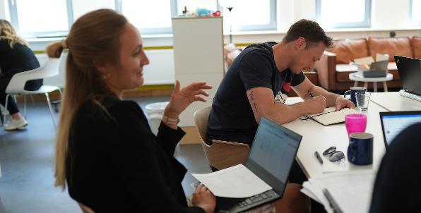
Subject areas
Our study courses
Mobility
Engineering
Business
Life Science
Digitalisation
Design & Media

Slide 7



Strategy 10.000
Further development of THI
Expansion
2023 : 2033
Internationalisation Sustainability
Employee
870
1.000
Entrepreneurship Digitalisation
Cross-sectoral
study courses
Faculties
Focus: Digital skills
6
6
Life Sciences
Sustainable Infrastructure
Students
Mobility
7.500
10.000
Study programmes
76
90

Slide 8








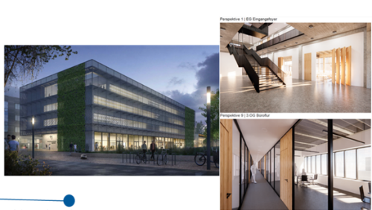



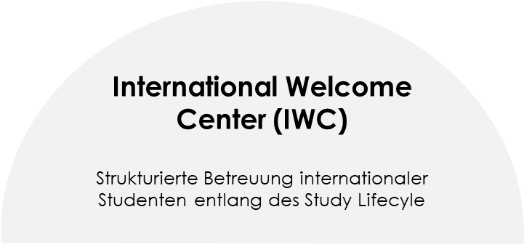
Further university goals according to the university contract
Further development of THI until 2027
Promotion of teaching innovations
Support of start-ups
and spin-offs
Expansion of the
AI-mobility center (up to 150 scientists)
Gender equality in
science
System- and AACSB-accreditation
Expansion of open access publications
Strenghtening interna-tional networks
Establishment of the
Doctoral School
Expansion of digitalisation in Teaching / Administration
Establishment of the
International Welcome Center
Sustainability strategy / Implementation of climate balance
Construction of new buildings in Ingolstadt and Neuburg

Slide 9
Higher education system
Structuring Bachelor > Master > PhD
PhD
Master
PhD
Bachelor
Master‘s Degree
approx. 4 years
Employment as a research assistant
PhD thesis
Bachelor‘s Degree
Semester 3
Theory/master thesis
In-depth studies
2nd stage of studies
Semester 7
Theory/bachelor thesis
Semester 2
Theory, if necessary in-depth specialisation
Master‘s Degree
Semester 6
Theory
Semester 1
Theory
Internship semester 5
Bachelor‘s Degree
Semester 4
Theory
Semester 3
Theory
Basic studies
1st stage of studies
Semester 2
Theory
Semester 1
Theory
Pre-Practice

Slide 10

Bachelor
Our study courses
Electrical Engineering and Information Technology
Engineering and Management
Mechanical Engineering
Autonomous Vehicle Engineering
Engineering and Business
Aerospace Engineering
Biomedical Engineering
Engineering and Management
Automotive Engineering
Electrical Engineering and Electric Mobility
Data Science in Engineering and Management
Biomechanics
Electrical Engineering and
Information Technology
Engineering Sciences
Technical Design
Energy Systems and Renewable Energies
Robotics
Mechanical Engineering
Computer Science
Business School
Sustainable Infrastructure
Aircraft and Vehicle Informatics
Business Administration
Industrial Engineering - Construction
Artificial Intelligence
Digital Business
Sustainable and Environmental Management
Business Information Systems
Global Economics and Business Mgmt.
Sustainable Building Materials Technology
Computational Life Sciences
International Management
Sustainable Civil Engineering
Computer Science and Artificial Intelligence
Life Science Management
Sustainability Management and Technologies
Computer Science
Media Psychology and Digital Business
Cybersecurity
User Experience Design

Slide 11
Master
Our study courses
Electrical Engineering and Information Technology
Engineering and Management
Mechanical Engineering
AI-Engineering of Autonomous Systems
Automotive Production Engineering
Aerospace Engineering
Applied Research in Engineering Sciences
Design Leadership
Automotive Engineering
Automated Driving and Vehicle Safety
Digital Procurement & Sustainable Supply Chain Management
Hydrogen Technologies and Economics
Electrical Engineering and Electric Mobility
Engineering and Business
Material Science in Engineering
International Automotive Engineering
Engineering and Management
Renewable Energy Systems
Patent Engineering
Global Foresight & Technology Mgmt.
Technical Development in Mechanical Engineering
Computer Science
Business School
Nachhaltige Infrastruktur
Artificial Intelligence
Automotive & Mobility Management
Sustainability Management and Technologies
Business Information Systems Engineering
Entrepreneurship and Digital Business
Cloud Applications and Security Engineering
Financial Management and Controlling
User Experience Design
Global Business
Marketing/ Sales / Media
Retail and Consumer Management
Taxation and Consulting

Slide 12




THISuccess^{AI}
Objective
Pilot test modules in STEM subjects & gradual expansion
Objective
Establishment of individualised learning paths using learning analystics in four pilot test modules to strenghten individual study success and reduce the dropout rate
Faculty Computer Science
Basics of mathematics
Basics of statistics
Faculty Electrical Engineering & Information Technology
Individual learning success
Basics of electrical engineering
Option 1: Recommendations based on lectures and the learning assistant (AI).
Basics of programming
Option 2: Own search with filter options (e.g. topic, learning objective, processing time, presentation, …)
THI Business School
Statistics
Learning progress visualised via dahboard
Chatbot-based assistance
Faculty Mechanical Engineering
CAD

Slide 13


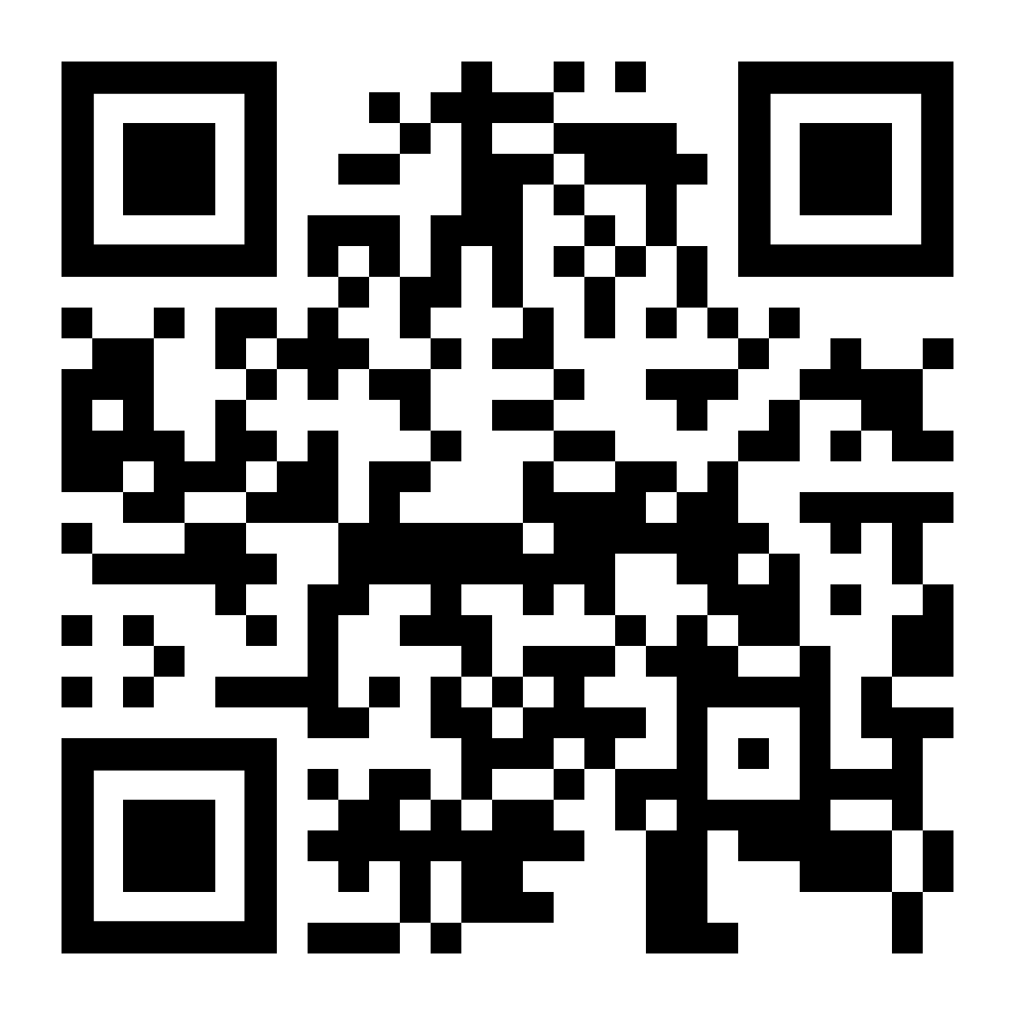
THISuccess^{AI}
Straight to the video:

Slide 14

Lifelong Learning (TCW)
Institute for
At THI‘s Campus for Lifelong Learning, around 400 students complete part-time or continuing education courses (Bachelor, Master, MBA).
Economics
Health Management
Part-time
study programmes
Technology
Automotive
IT

Slide 15














Practical & application-oriented
Our Teaching
> 300
Industry partners
Research and Teaching
> 1.000
Theses and projects in cooperation with companies
90
Partners in dual studies
etc.

Slide 16


International
Exchange
160
Partner universities
400
Outgoings p.a.
Study abroad / Internship abroad
16
English taught
study courses
approx. 50 % of graduates have
experience abroad
Audi Konfuzius-Institut
Ingolstadt
Bavarian Center for Applied Research
and Technology with Latin America (AWARE)
Notes:
European University Association (EUA)

Slide 17
International
Exchange
Sweden
Iceland
Norway
F
inland
Russia
UK
Denmark
Ireland
P
oland
Netherlands
Belgium
Czech Republic
France
Hungary
Austria
Croatia
Italy
Romania
Spain
B
ulgaria
G
reece
Canada
USA
Japan
Turkey
S
outh Korea
Cyprus
China
Mexico
Jordan
Taiwan
Philippines
Costa Rica
V
ie
tnam
Venezuela
Nigeria
Malaysia
Colombia
Cameroon
I
Indonesia
Brazil
Peru
Zambia
Namibia
Australia
Chile
South Africa
Argentina
India
Thailand

Slide 18
Focus on international students
Further development of THI until 2027
The lack of professionals in Germany (3 million by 2030) requires more international students to stay in Germany
THI is growing due to international students. High increase in 2023/24 continues. One in three new students is international.
Status 2023
Plan 2027
Status 2023
Plan 2027
67 (2%)
497 (17%)
70 (2%)
500 (16%)
183 (2%)
1.028 (14%)
215 (3%)
1.520 (18%)
877 (12%)
1.428 (49%)
409 (14%)
1.390 (45%)
615 (20%)
44 (1%)
1.320 (16%)
4.215 (50%)
16 (1%)
4.260 (57%)
1.045 (14%)
50 (1%)
25 (1%)
495 (17%)
520 (17%)
1.080 (13%)
First-year students Bachelor Germany
First-year students Master Germany
Students Bachelor Germany
Students Master Germany
First-year students Bachelor EU (without GER)
First-year students Master EU (without GER)
Students Bachelor (without GER)
Students Master EU (without GER)
First-year students Bachelor not EU
First-year students Master not EU
Students Bachelor not EU
Students Master not EU
Growing uo of new students nationally and internationally
Growing up of students nationally and internationally
Notes:
Freshmen Bachelor Germany
Freshmen Bachelor EU (without GER)
Freshmen Bachelor not EU

Slide 19





Establishment of an International Welcome Center
Further development of THI until 2027
Introduction of a service fee of 500 € for each student outside the EU, starting in winter semester 24/25
Start of the service: For prospective students and applicants for the winter semester 24/25
International scientists
Integration
Increased acquisition of international scientists, expansion of partnerships, etc.
Qualification in German language and culture, alongside studying at THI.
Onboarding
Accompany arrival in Germany, Bavaria & Ingolstadt, including living space.
Strengthening employability
Advice on internships, teaching soft skills, work etiquette in Germany, application check, etc.
International Welcome Center (IWC)
Structured support for international students along the “Study Lifecyle”
Acquisition
Targeted acquisition, information and advice for international prospective students.
Settling in
Objective: Reducing the lack of professionals

Slide 20
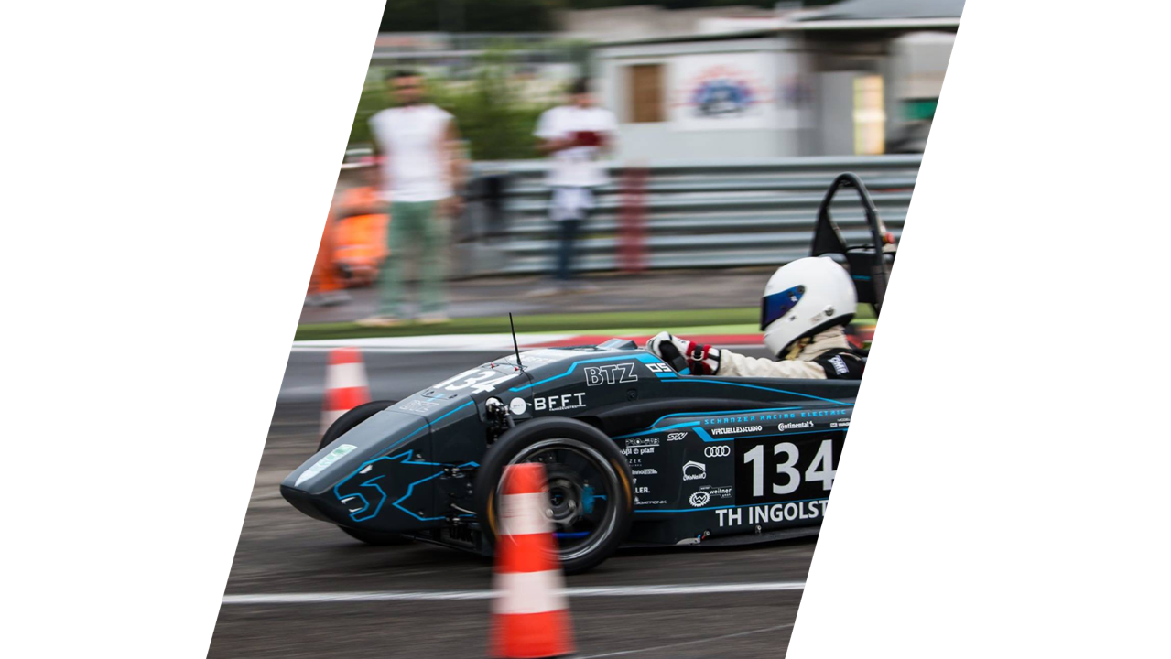









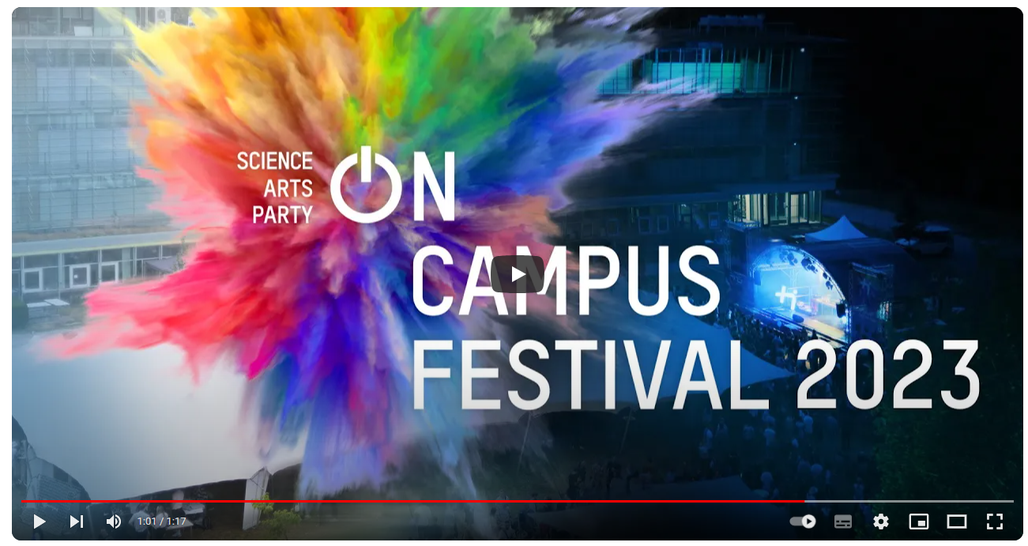
Technische Hochschule Ingolstadt
Student life
Over 15 student clubs
Wide range of university sports and leisure activities
On Campus Festival:

Slide 21
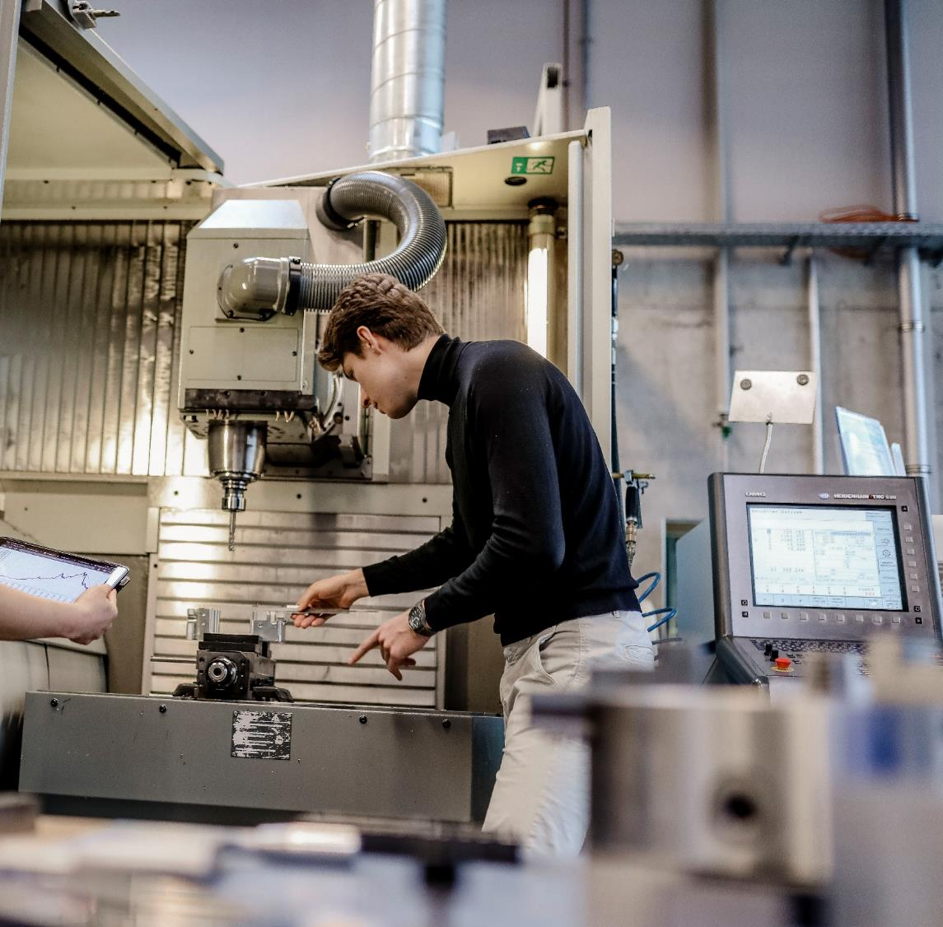




Our research
32 Mio. €
Research volume
Research
priorities
Institutes
CARISSMA
Vehicle safety
C-ECOS
Autonomous driving / AI
C-IAD
C-ISAFE
AImotion Bavaria
Vehicle safety
Institute for Innovative Mobility
Affiliated Institutes
Aviation / Unmanned flying
Institute for New Energy Systems
Battery/Smart Cell research
Bavarian Foresight-Institute
Fraunhofer
Energy systems
Research- and Transfer center
ForTraNN
Institute for Applied Sustainability
Sustainability

Slide 22
CARISSMA – Nationwide leading scientific center for vehicle safety
Our research
Nationwide leading scientific center for vehicle safety;
inaugurated in 2016
First research building at a universitiy for applied
sciences in Germany
> 100 scientific employees
10 laboratories and 2 universal test areas
Office
Indoor-test facility
Start-up and test track: 120 m
Circular driving dynamics area
Diameter: 60 m

Slide 23
Doctorate
Our research
THI was awared the right to award doctorates for Bavarian
UAS according to a quality-guided process
Two independent doctoral centers at THI
„AI / Computer Sciences“ and „Engineering Sciences“
Currently: Establishment of the Doctoral School
December 2023: Admission of the first
doctoral students
Doctor of
Natural Sciences (Dr. rer. nat.)
Doctor of
Engineering Sciences (Dr.-Ing.)
Doctor of
Philosophy (Dr. phil.)

Slide 24


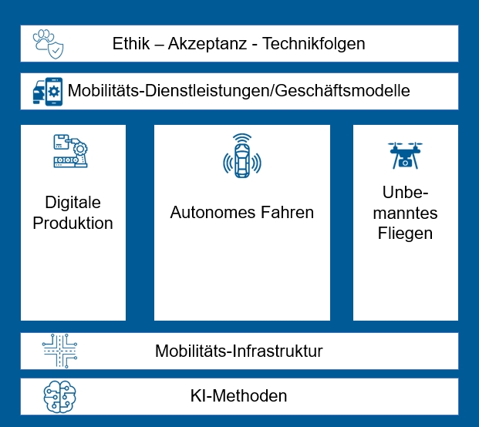
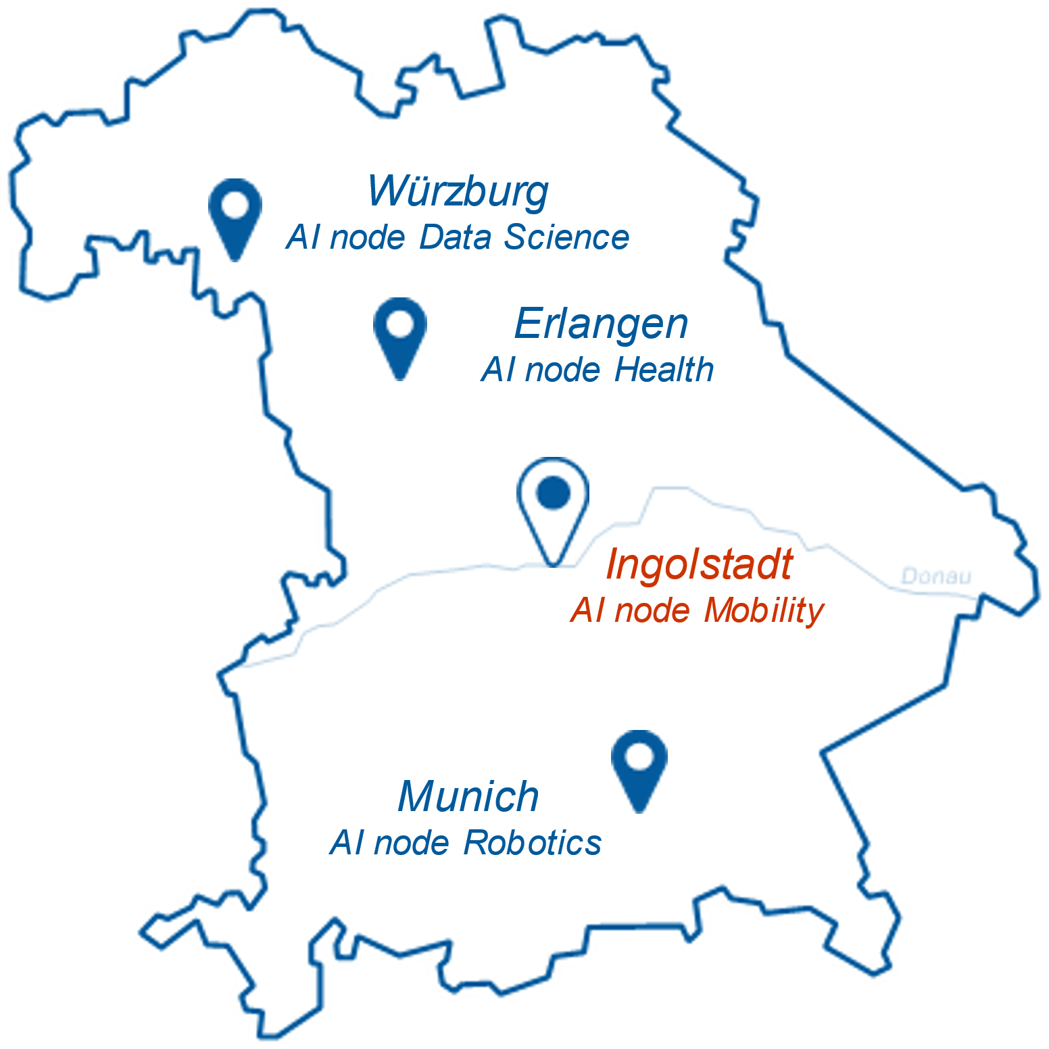
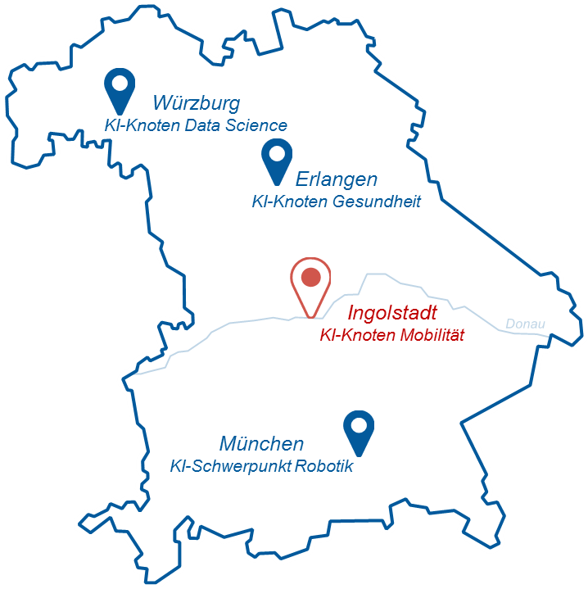


Bavarian AI-Center
Our research
Establishment of an AI-mobility center with more than 150 scientists by 2025
AI research professorships by AImotion Bavaria, which are largely financed by the Hightech Agenda Bavaria
Networking with other AI centers in Bavaria
Ethics – Acceptance – Technology consequences
Mobility services / Business models
Digital production
Un-
manned
flying
Autonomous driving
Mobility infrastructure
AI methods

Slide 25


Sustainability on focus
Our research
Applied energy research on the Institute for New Energy Systems (InES)
Platform for trans- and interdisciplinary desing of sustainable development in the region: Research and Transfer Center Neuburg (ForTraNN)

Slide 26

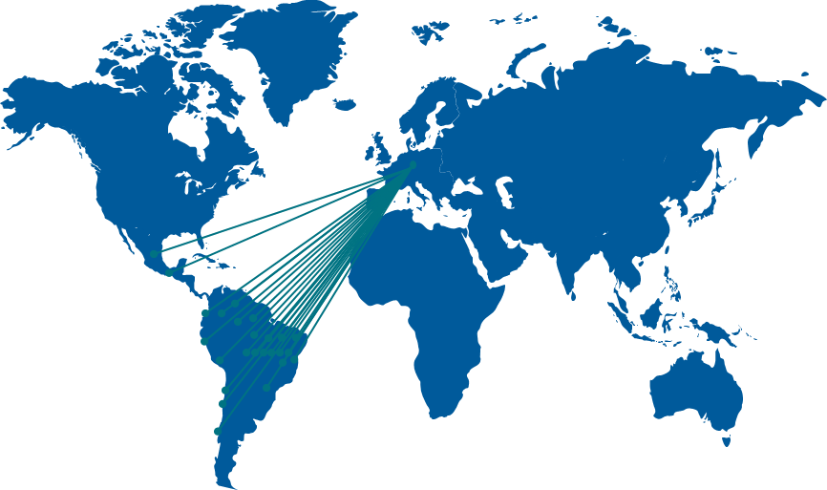
Center for Applied Research and Technology with Latin America
Our research
Broad network of universities (26) and industrial partners (20) from Bavaria and Latin America
Applied research and technology transfer
Over 10 years of experience in fundraising and management of industry-academia projects
Focus on applied technologies in the fields of mobility, AI, sustainability and energy
Promotion of career opportunities for Latin American researchers at THI

